Slide 1

Data analytics project
Shreya Sharan
​

Slide 2
Table of contents
1
2
3
4
5
Introduction
Data collection and preparation
Statistical Analysis & Insights
Exploratory Data Analysis
Conclusion and references

Slide 3

E-commerce furniture data analysis
1.1 About Data
This project analyzes an e-commerce furniture dataset scraped from AliExpress, containing 2,000 product entries. The dataset includes key details such as product titles, original prices, discounted prices, units sold, and product tags. By leveraging SQL, Python, and data visualization techniques, the project aims to explore market trends, pricing strategies, and consumer purchasing behaviors. Through data cleaning and exploratory analysis, valuable insights are derived to understand sales patterns and the impact of discounts on customer preferences

Slide 4

We will use the dataset named furniture, which will contain the following columns for various types of analysis.
Overview of Columns in the Dataset
ProductTitle – Name and description of the furniture item.
OriginalPrice – The initial price of the product before any discount.
Price – The final selling price after discounts.
Sold – Number of units sold.
TagText – Additional product tags (e.g., "Free shipping").

Slide 5
1.2 Objective of the project
1. Sales Trend Analysis
Identify best-selling and least-selling furniture.
Analyze price impact on sales.
2. Price & Discount Impact
Study how discounts affect sales.
Find optimal price ranges for higher revenue.
3. Customer Preferences
Identify popular product tags and categories.
Analyze how price points influence purchases.
4. Market Insights
Compare original vs. selling prices.
Spot high-performing and underperforming products.

Slide 6
2. Data collection and preparation
2.1 Data sources
The dataset was collected in compliance with ethical standards, ensuring respect for user privacy and platform terms of service.
Data is structured and clean, suitable for further analysis and modeling
2.2 Tools used
SQL for data cleaning and analyze the data.
Tableau for visualisation and exploratory data analysis.

Slide 7
2.3 Data cleaning and preprocessing
Before performing any analysis, the data should be cleaned.
Deleting duplicate records.
create table furniture_data as
(select * from furniture
union
select * from furniture);
-- This will create a table with unique records.
Deleting null values
delete from furniture_data
where producttitle is null
or originalprice is null
or price is null
or sold is null
or tagtext is null;

Slide 8
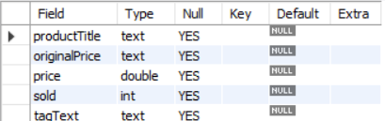
Checking the structural formats.
desc furniture_data;
Here we can see that the datatype of the original price column is text, whereas it should be float.
-- First of all, the commas in the data should be replaced by spaces
update furniture_data
set originalprice=replace(originalprice,",","");
-- Now we will update the empty values with null values
update furniture_data
set originalprice=null
where originalprice='';
-- Now we will alter the datatype of original column
alter table furniture_data
modify column originalprice float;
--Since the datatype of the column has changed, we will replace the null values with zero
update furniture_data
set originalprice=0
where originalprice is null;

Slide 9
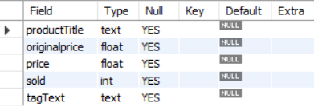
Altering the datatype of price column
alter table furniture_data
modify column price float;
There are some different values of some rows in tag text column where shiiping was not free update furniture_data
set tagtext="Paid shipping“
where tagtext !="free shipping";
Now, the structure seems correct.

Slide 10

Statistical Analysis & Insights

Slide 11
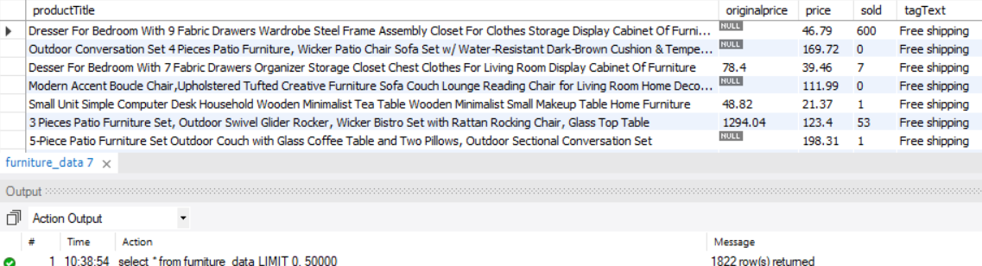
Basic overview
Total rows
select * from furniture_data;
Total distinct products
select distinct(producttitle) as unique_products from furniture_data;

Slide 12
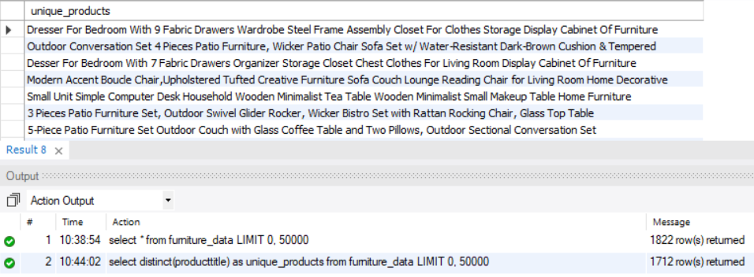
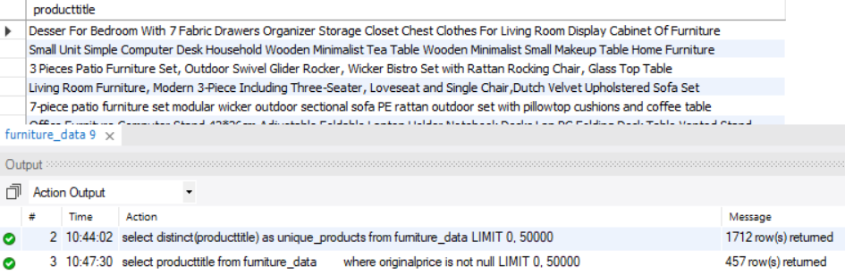
Products where original price is given
select producttitle from furniture_data
where originalprice is not null;

Slide 13
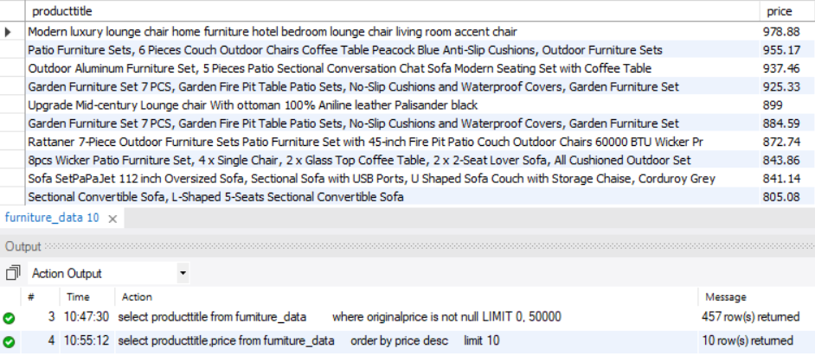
Pricing analysis
10 most expensive products
select producttitle, price from furniture_data
Order by price desc
limit 10;

Slide 14
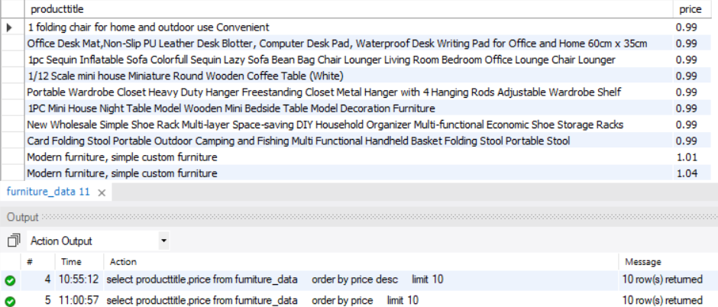
10 least expensive products
select producttitle, price from furniture_data order by price limit 10;

Slide 15
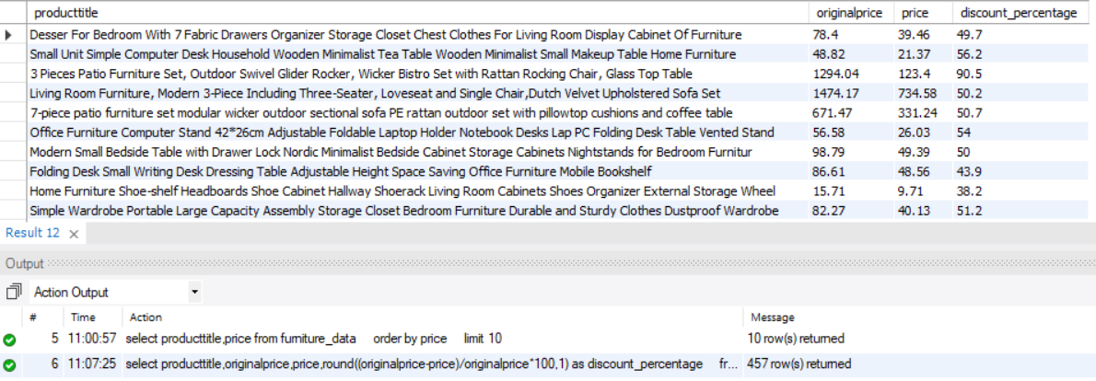
Average discount (where original price is given)
select producttitle,originalprice,price,round((originalprice-price)/originalprice*100,1)as
discount_percentage from furniture_data where originalprice is not null;

Slide 16
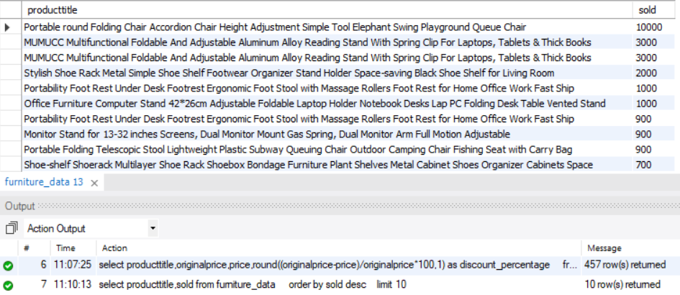
Sales analysis
Best-selling products
select producttitle, sold from furniture_data order by sold desc
limit 10;

Slide 17
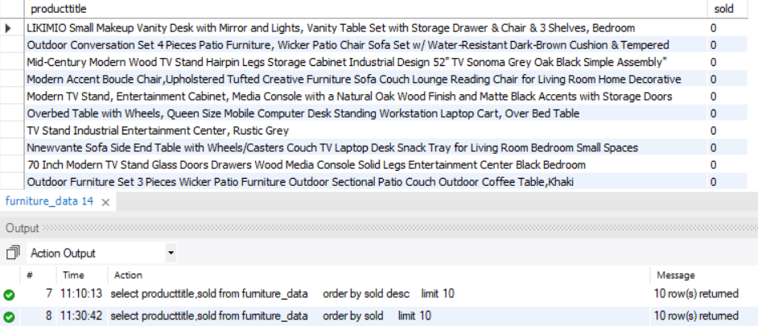
least selling products or no sale
select producttitle, sold from furniture_data order by sold limit 10;

Slide 18
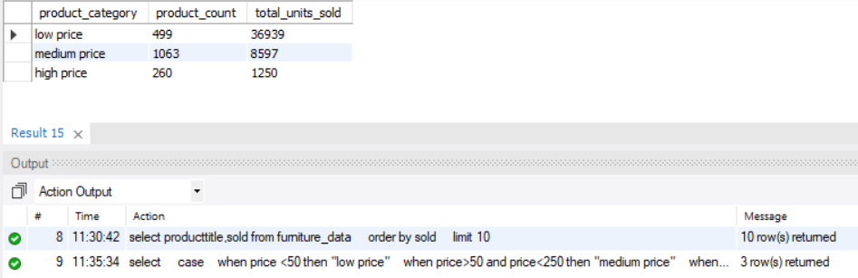
Price range by sales
select case
when price <50 then "low price"
when price>50 and price<250 then "medium price"
when price >200 then "high price"
end as product_category,
count(*) as product_count,
sum(sold) as total_units_sold from furniture_data
group by product_category
order by total_units_sold desc;

Slide 19
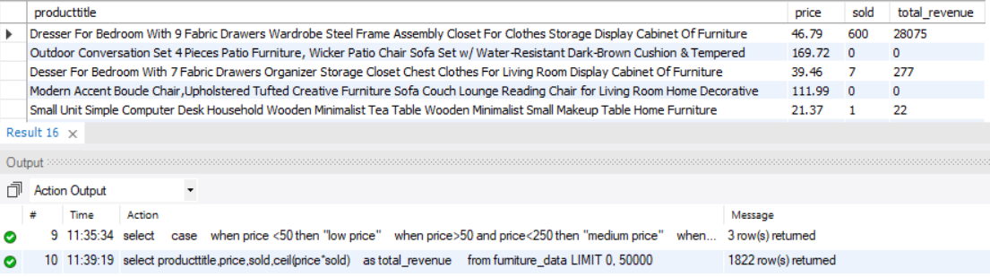
Revenue Insights
Total revenue generated by each product
select producttitle, price, sold, ceil(price*sold) as total_revenue
from furniture_data;

Slide 20
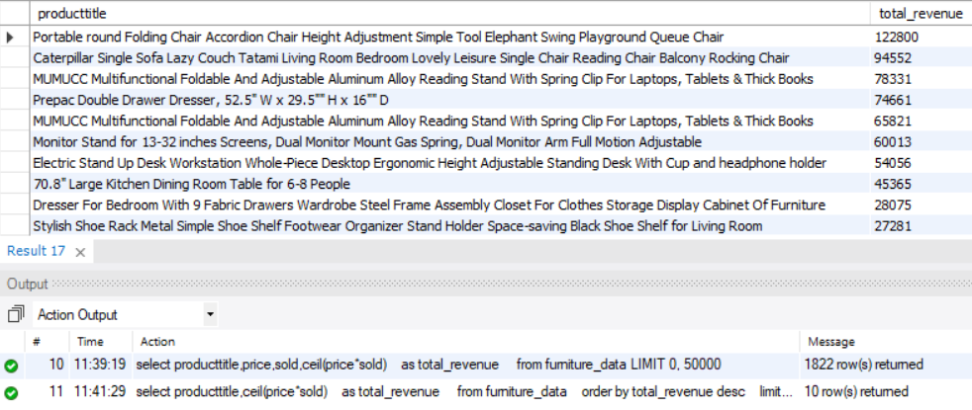
Identifying the top products contributing most to the revenue.
select producttitle, ceil(price*sold) as total_revenue
from furniture_data order by total_revenue desc limit 10;

Slide 21
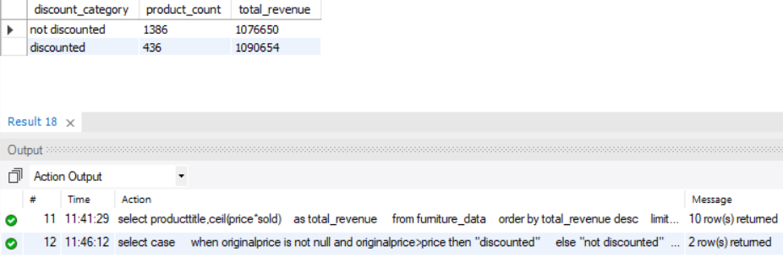
Compare revenue from discounted V/S non-discounted items.
select case
when originalprice is not null and originalprice>price then "discounted"
else "not discounted"
end as discount_category,
count(*) as product_count,
floor(sum(price*sold)) as total_revenue
from furniture_data
group by discount_category;

Slide 22
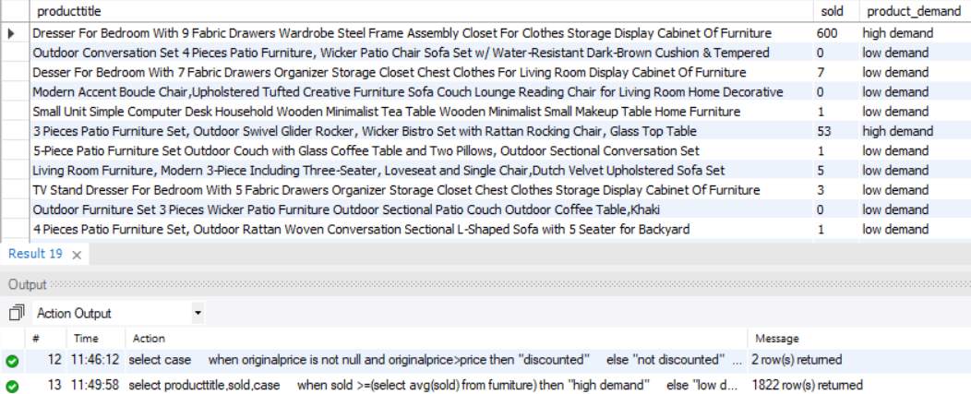
Category-based trends
Analysis based on demand of the product
select producttitle, sold, case
when sold >=(select avg(sold) from furniture) then "high demand"
else "low demand"
end as product_demand
from furniture_data;

Slide 23
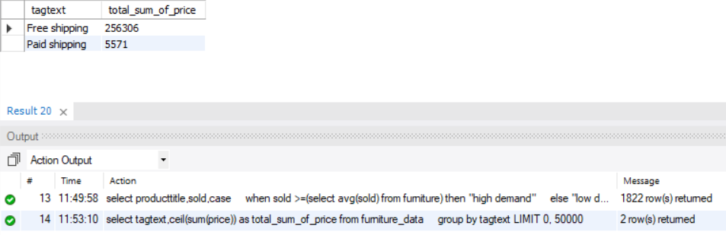
Shipping Impact
Comparing price distribution for products with different tagtext values.
select tagtext, ceil(sum(price)) as total_sum_of_price from furniture_data
group by tagtext;

Slide 24

Exploratory Data Analysis

Slide 25
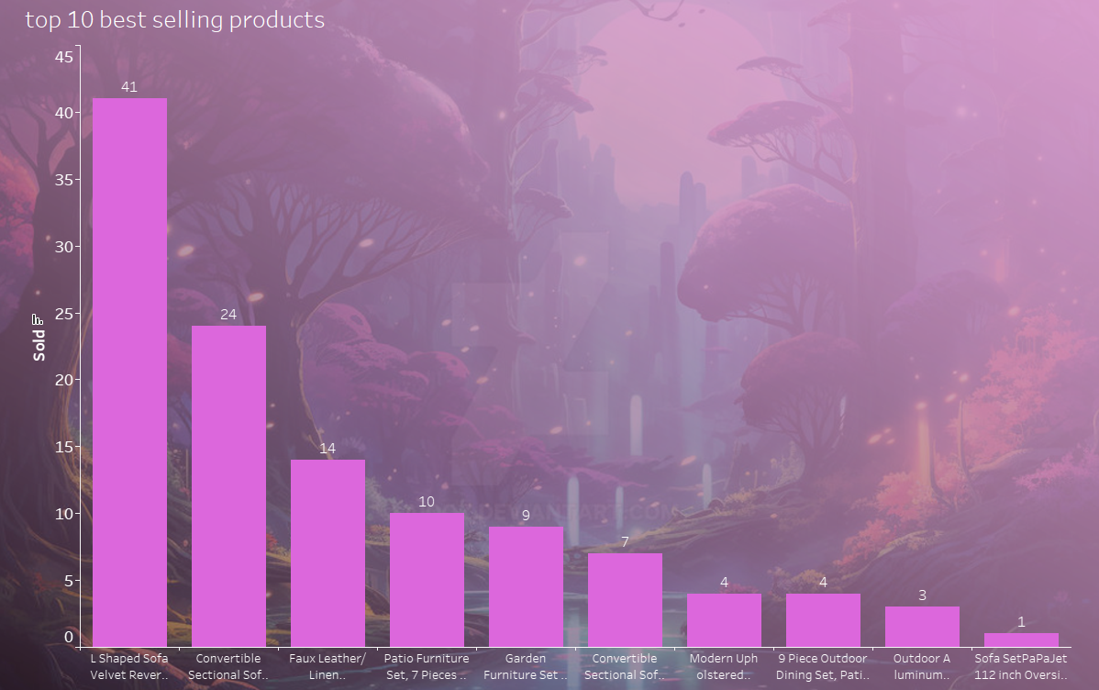
Top 10 best selling products
Best Seller: L Shaped Sofa Velvet Reversible Sectional Sofa – 41 units sold. Big hit due to storage + comfort + design.
Trend Alert: Convertible Sectional Sofas dominate the list – modular, multi-use furniture is in demand.
Outdoor Boom: 4 out of top 10 are outdoor sets – growing interest in patio and garden setups.
Features > Price: Products with added features (like storage/chaise) sell better even if priced higher.
Hot Categories: Living room seating and outdoor furniture are top-performing product types.

Slide 26

Shipping trends
Free Shipping = 1,605 products
Paid Shipping = 117 products
Free shipping dominates — over 93% of products offer it, making it a key customer attraction.

Slide 27
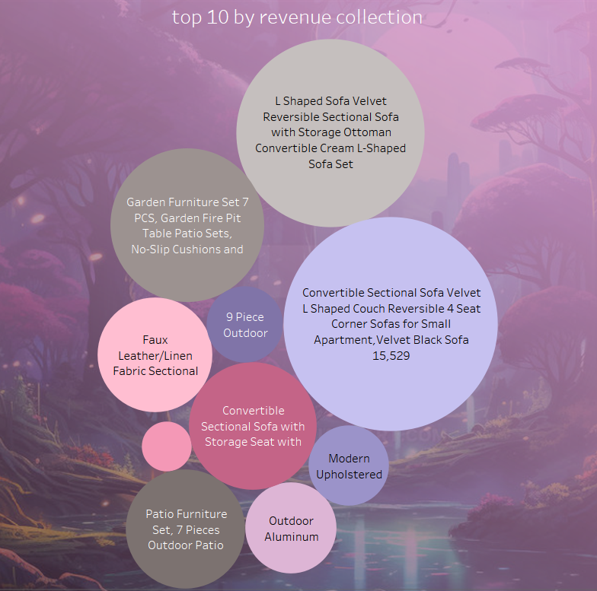
10 Top revenue-generating products
Top revenue-generating products are mainly L-shaped and convertible sectional sofas with features like velvet fabric, storage ottoman, and reversibility. The Convertible Sectional Sofa Velvet Black alone collected ₹15,529, showing that customers are willing to spend more on premium, multifunctional furniture that adds both style and utility to their homes.

Slide 28
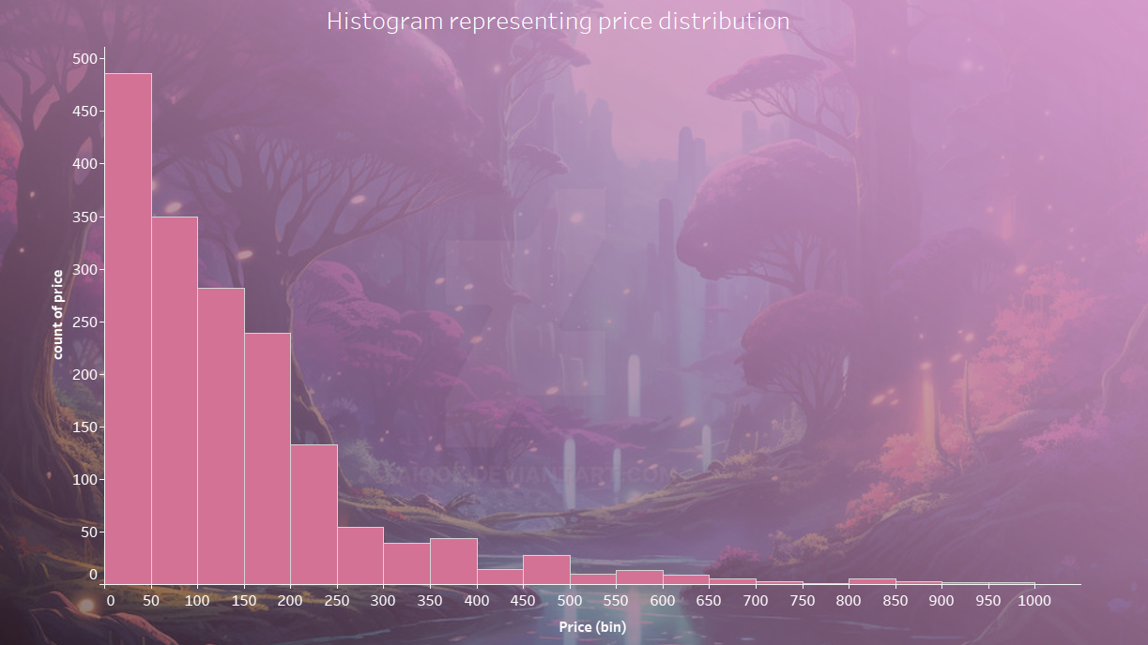
Histogram representing price distribution
Most products are priced under ₹200, with the highest concentration between ₹0–₹100. As price increases, product count sharply decreases — showing that budget-friendly furniture dominates the market and is more frequently listed.

Slide 29
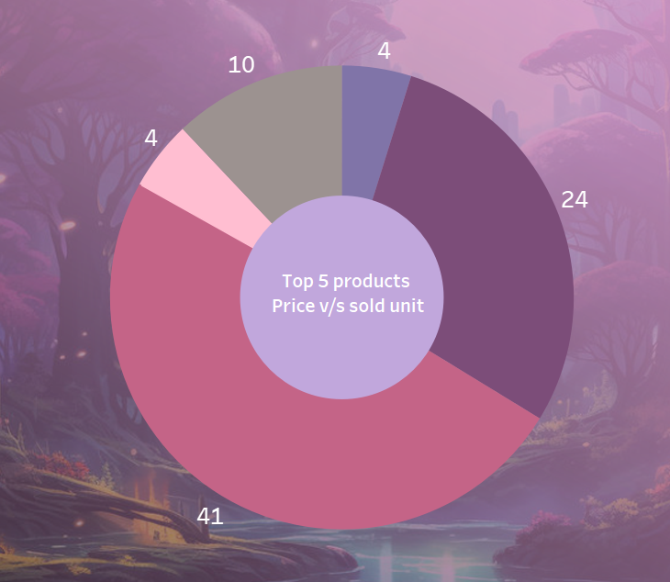
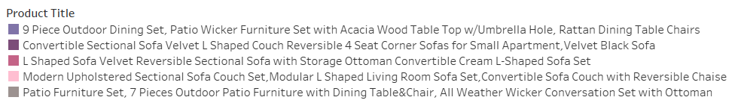
Top 5 products price v/s sold unit
The "Modern Upholstered Sectional Sofa Couch Set" leads with a 41% price-to-sold-unit ratio, followed by the "9 Piece Outdoor Dining Set" at 24%. "L-Shaped Sofa Velvet" is at 10%, while "Convertible Sectional Sofa" and "Patio Furniture Set" both sit at 4%, indicating the sofa set is priciest relative to sales, with patio sets showing better sales efficiency.

Slide 30
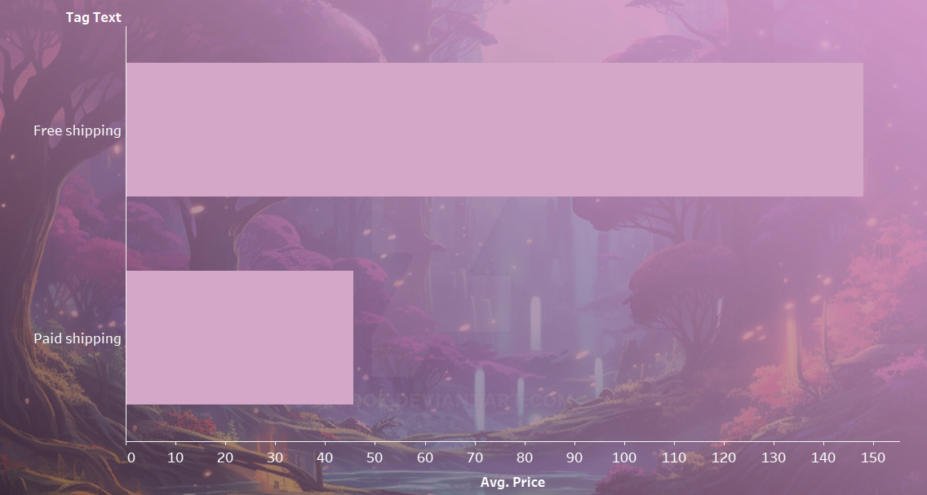
Average price of discounted v/s non-discounted products
Free shipping products average over 140, indicating premium pricing.
Paid shipping products average 40-50, targeting budget buyers.
Free shipping likely applies to higher-value items, paid to lower-cost ones.

Slide 31

Conclusion and recommendations

Slide 32





Conclusion
Consumer Preferences
Data shows clear customer preferences for specific furniture types and price points.
Pricing Impact
Discounts strongly influence purchasing decisions, guiding pricing strategies.
Feature Influence
Free shipping boosts product appeal and drives higher sales.
Market Trends
Popular products and price ranges highlight 2024 retail trends.
Business Insights
Informs inventory, marketing, and product focus for better sales.

Slide 33
Recommendations
Offer competitive discounts to drive sales based on pricing insights.
Emphasize free shipping to attract more buyers, as it boosts purchases.
Stock trending furniture types to meet customer demand.
Use clear, keyword-rich product titles to enhance visibility.
Align inventory with high-demand items to avoid excess stock.
Monitor dataset trends to adapt to changing consumer preferences.

